Slide 1
Data Structures
Lecture 12
Binary Search Tree
Prantik Paul [PNP]
Lecturer
Department of Computer Science and Engineering
BRAC University

Slide 2
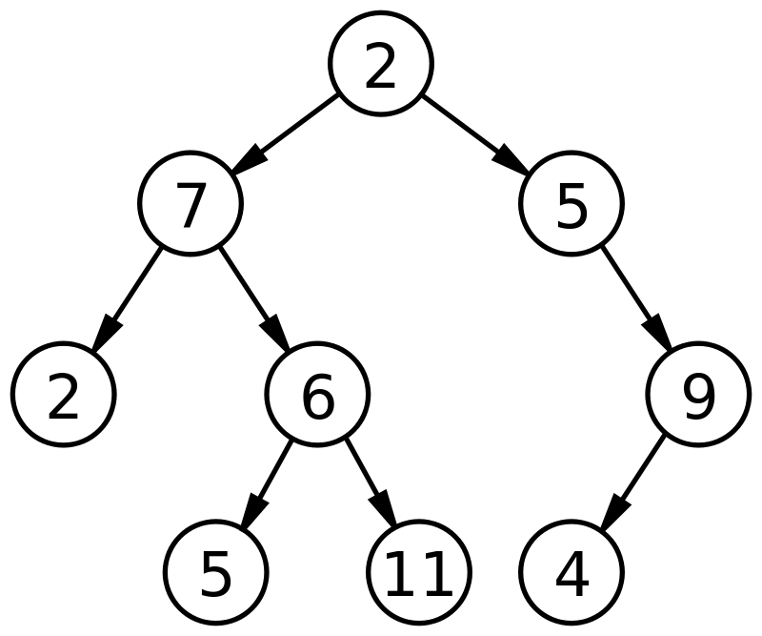
Binary Tree

Slide 3
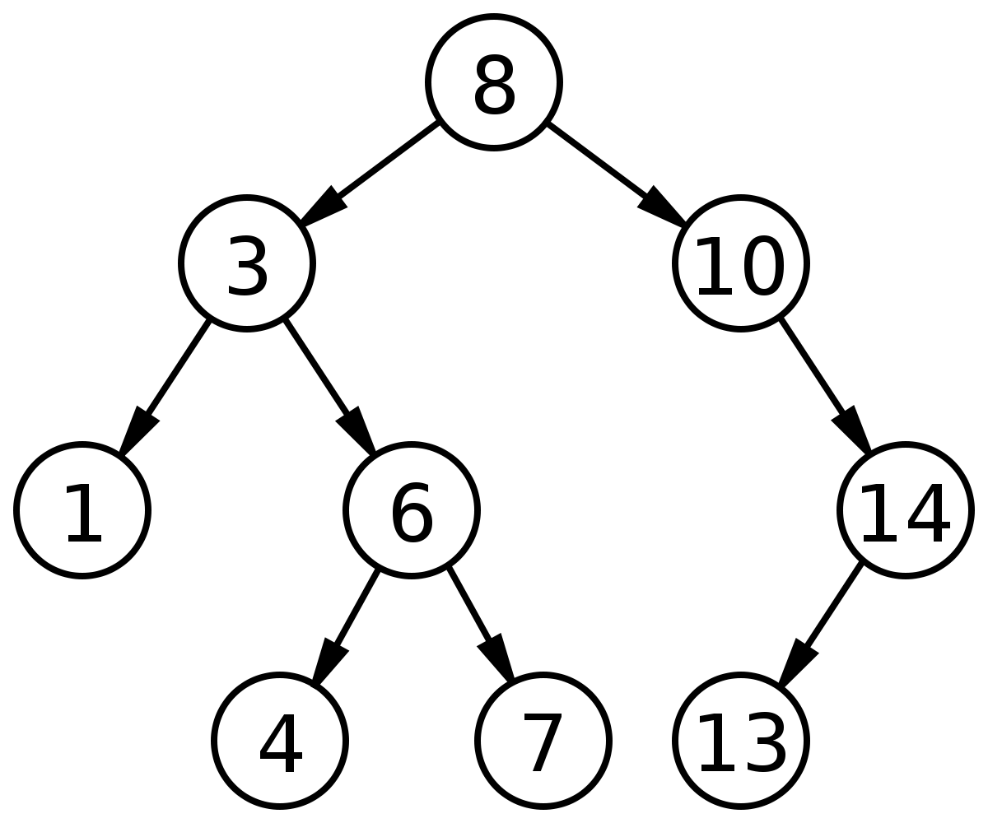
Binary Search Tree

Slide 4
Binary Search Tree - Restrictions
Elements of Left Subtree < Element of Parent
Elements of Right Subtree> Element of Parent
Left and Right Subtree also BST’s
No Duplicate Values

Slide 5
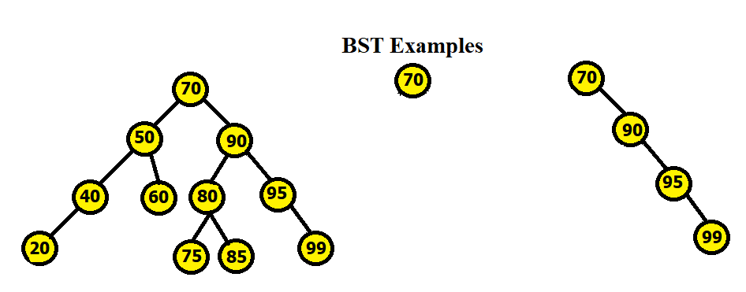
Binary Search Tree

Slide 6
Binary Search Tree - Why to use
Search 7
Search 5

Slide 7
Binary Search Tree - Why to use
Search 12
Must be Balanced

Slide 8
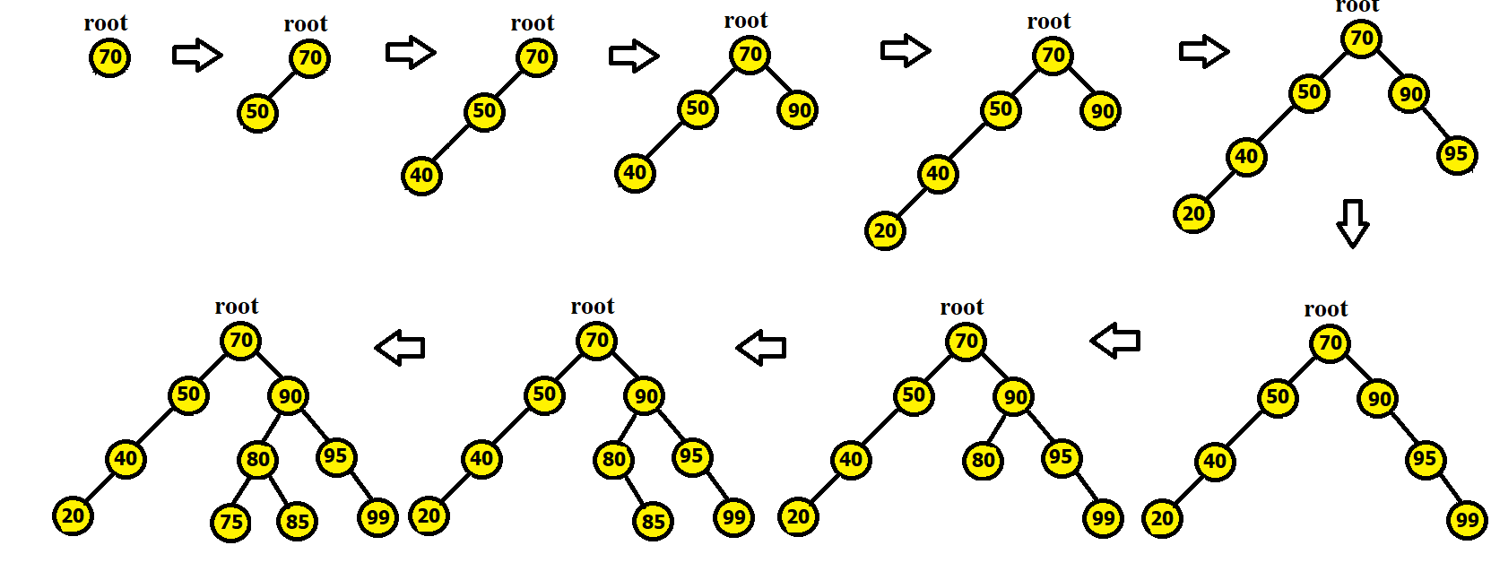
Binary Search Tree - Creation
70, 50, 40, 90, 20, 95, 99, 80, 85, 75

Slide 9

Binary Search Tree - Creation
70, 50, 40, 90, 20, 95, 99, 80, 85, 75

Slide 10
Binary Search Tree - Insertion
Insert 10
Insert 5
Must Make Balanced

Slide 11
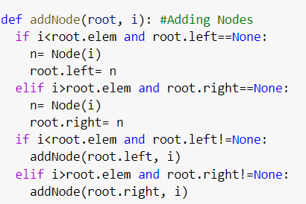
Binary Search Tree - Insert Node

Slide 12
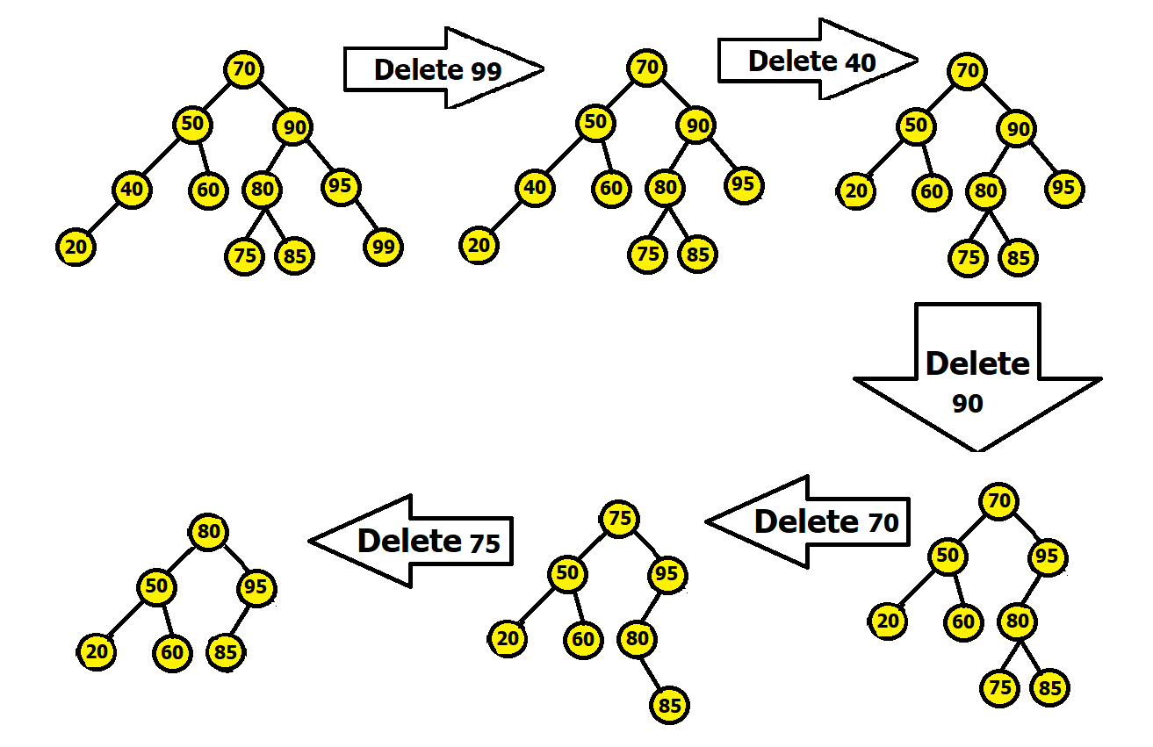
Binary Search Tree - Deletion
Case 1: No Subtree or Children
Delete 99

Slide 13
Binary Search Tree - Deletion
Case 2: Only 1 Subtree or Child
Delete 40

Slide 14
Binary Search Tree - Deletion
Case 3: 2 Subtrees or Children (Replace by Inorder Successor)
Delete 90

Slide 15
Binary Search Tree - Deletion
Case 3: 2 Subtrees or Children (Replace by Inorder Predecessor)
Delete 90

Slide 16
Binary Search Tree - Deletion
Case 3: 2 Subtrees or Children (Replace by Inorder Successor)
Delete 70

Slide 17
Binary Search Tree - Deletion
Case 3: 2 Subtrees or Children (Replace by Inorder Predecessor)
Delete 70

Slide 18
Binary Search Tree - Deletion
Case 3: 2 Subtrees or Children (Replace by Inorder Successor)
Delete 75

Slide 19
Binary Search Tree - Deletion
Case 3: 2 Subtrees or Children (Replace by Inorder Predecessor)
Delete 75

Slide 20
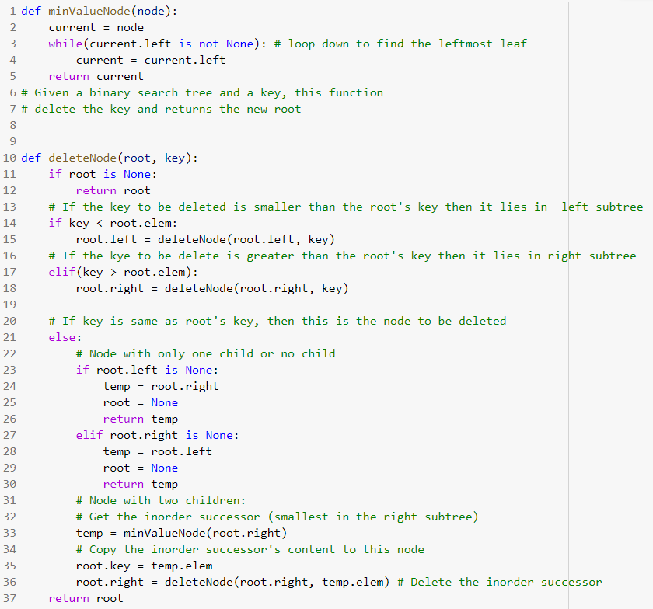
Binary Search Tree - Delete Node

Slide 21
Binary Search Tree - Delete Node

Slide 22
Binary Search Tree - Delete Node

Slide 23
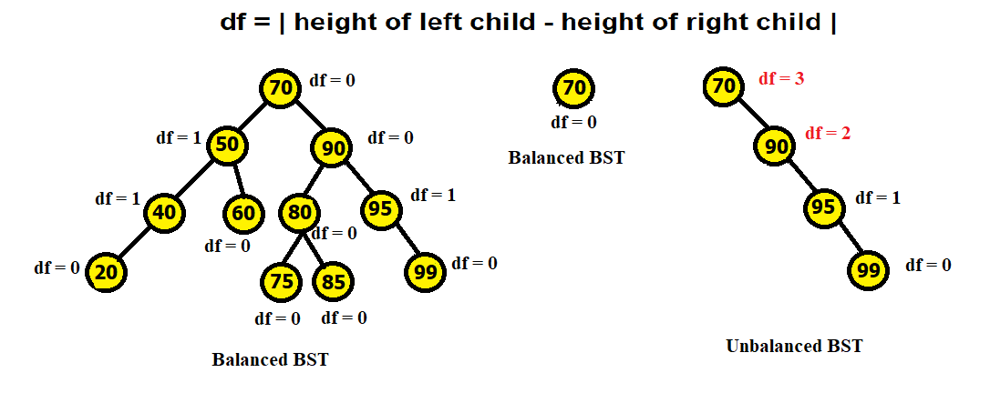
Binary Search Tree - Balancing

Slide 24
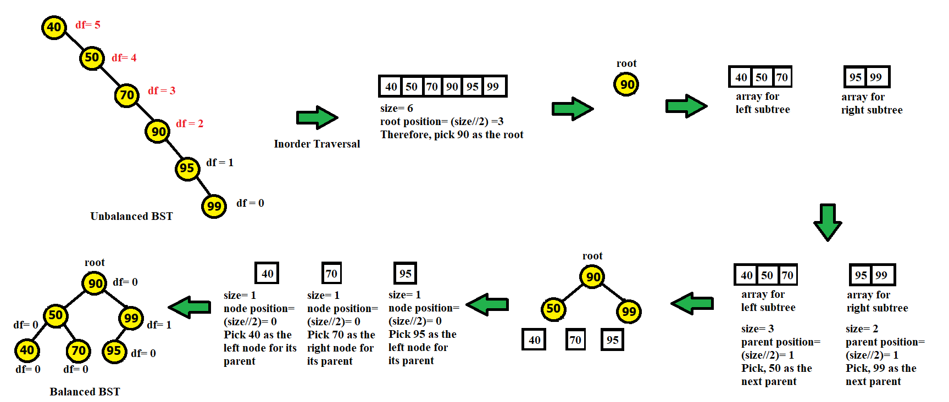
Binary Search Tree - Balancing

Slide 25
Binary Search Tree - Balancing

Slide 26
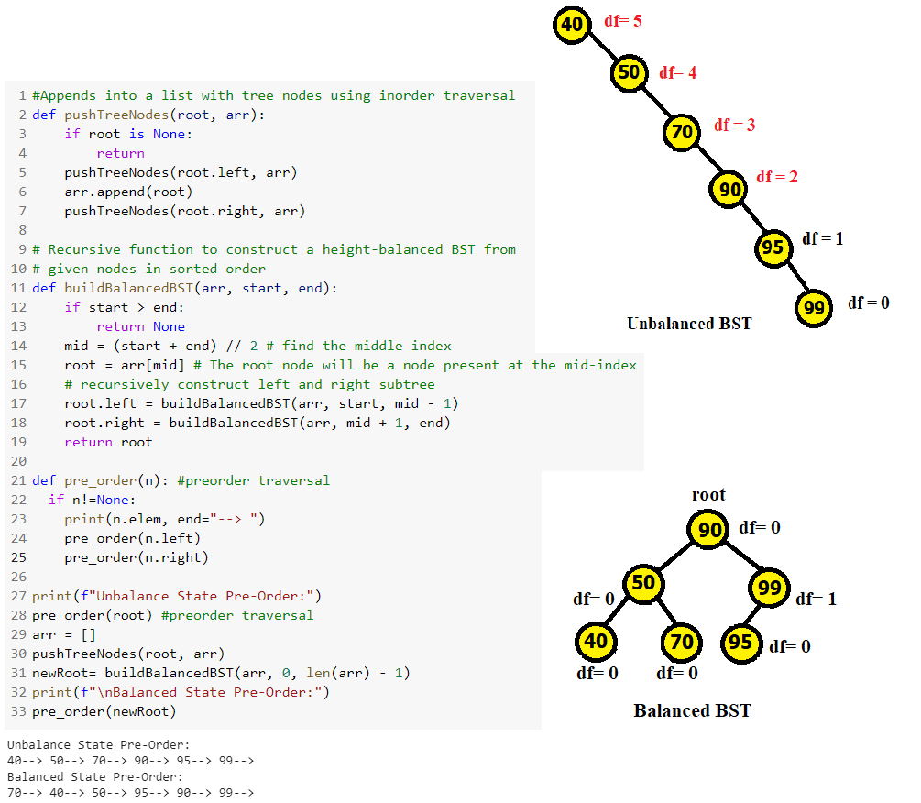
Binary Search Tree - Balance Tree

Slide 27
Binary Search Tree - Balance Tree

Slide 28
Binary Search Tree - Search Node in Tree
Search a node in a BST
DIY

